Slide 1
Lecture 2
System Analysis
and Design

Slide 2
Chapter 1
_{System Concepts and the}
_{Information System Environment}
Chapter 1
SP

Slide 3
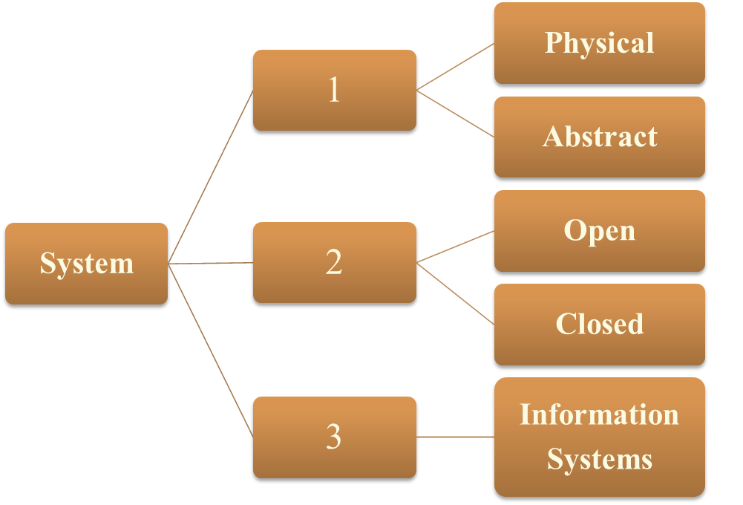
Types of Systems
Chapter 1
SP

Slide 4
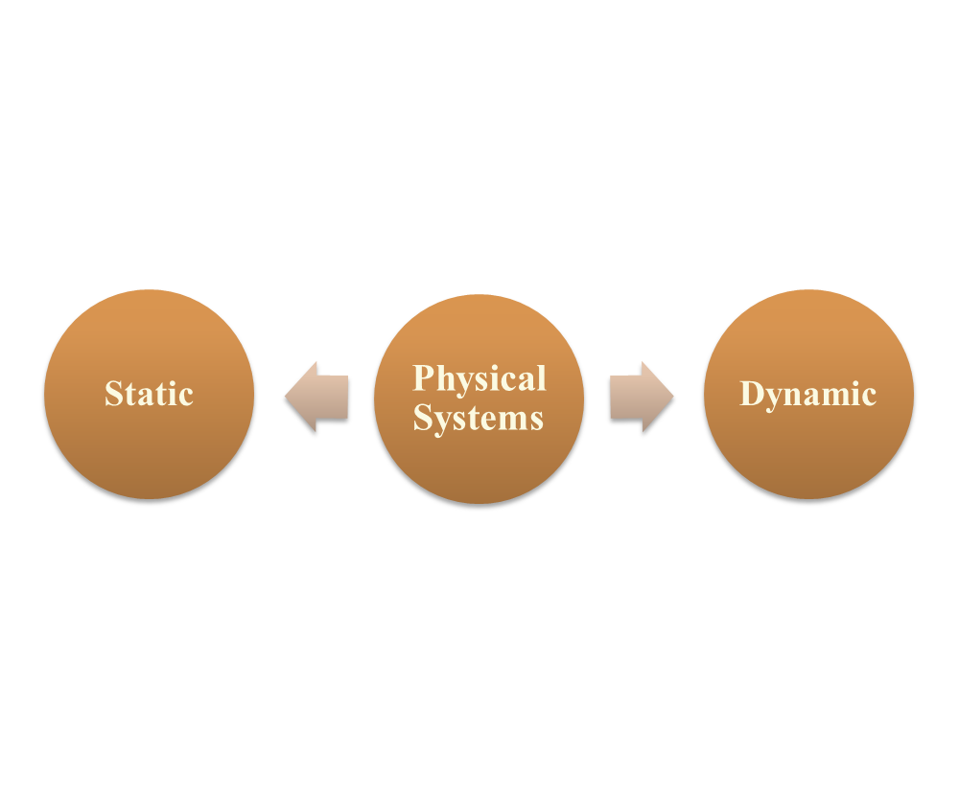
Physical Systems
Physical systems are tangible entities
Chapter 1
SP

Slide 5
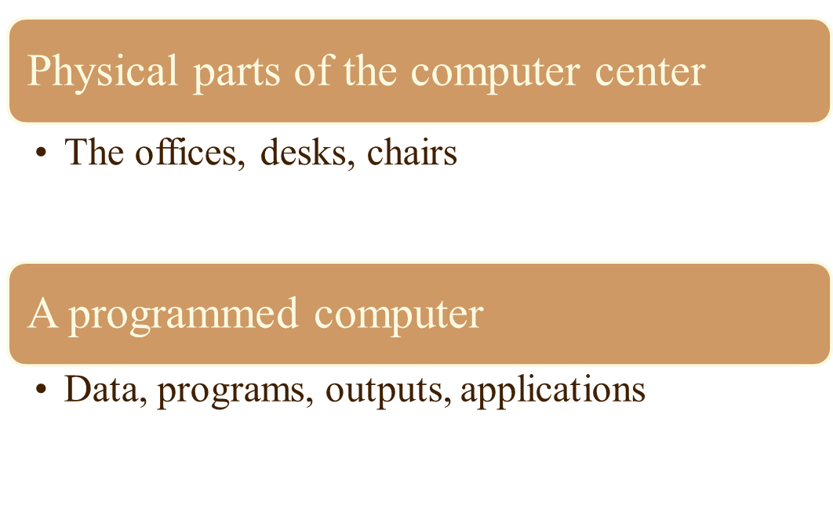
Physical Systems . .
Chapter 1
SP

Slide 6
Abstract Systems
Abstract systems are conceptual or nonphysical entities.
Example:
Formulas of relationships among sets of variables
Models
What is a model?
The abstract conceptualization of Physical systems
A representation of a real or planned system
Chapter 1
SP

Slide 7
Open and Closed Systems
This classification of systems is based on their degree of independence.
Open System
An open system has many interfaces with it’s environment.
It permits interaction across it’s boundary.
Example
An information system – since it
must adapt to the changing
demands of the user.
Closed System
A closed system is isolated from
environmental influences.
Example
In reality, a completely closed
system is rare.
Chapter 1
SP

Slide 8
Open Systems characteristics
Input from Outside
Entropy
Process, output and cycles
Differentiation
Equifinality
Chapter 1
SP

Slide 9
Open Systems characteristics
Input from Outside
Open systems are self-adjusting and self-regulating.
When functioning properly, an open system reaches a steady state or equilibrium.
Entropy
All dynamic systems tend to run down over time, resulting in entropy or loss of energy.
Open systems resist entropy by seeking new inputs or modifying the processes to return to a steady state.
Chapter 1
SP

Slide 10
Open Systems characteristics ..
Process, output and cycles
Open systems produce useful output and operate in cycles, following a continuous flow path.
Differentiation
Open systems have a tendency toward an increasing specialization of functions and a greater differentiation of their components.
Equifinality
It implies that goals are achieved through differing courses of action and a variety of paths.
Chapter 1
SP

Slide 11
Information Systems
Definition
An "Information System” may be defined as a set of devices, procedures and operating systems designed around user-based criteria to produce information and communicate it to the user for planning, control and performance.
Things to notice and remember here:
a set of devices, procedures and operating systems
designed around user-based criteria
to produce information and communicate it to the user
for planning, control and performance
Chapter 1
SP

Slide 12
Major information systems
Many system analysts fail to recognize that –
a business has several information systems.
each of them are designed for a purpose
and works to accommodate data flow, communications, decision making, control and effectiveness.
Three major information systems are:
Formal
Informal
Computer-Based
Chapter 1
SP

Slide 13
Formal Information system
A formal information system is based on the organization represented by the organization chart.
It is concerned with the pattern of authority, communication and work flow.
Information is formally disseminated in instructions, memos or reports from top management to the intended user in the organization.
This structure also allows feedback up the chain of command for follow-up.
Chapter 1
SP

Slide 14
Formal Information system . .
Disadvantage:
The formal information system is a power structure designed to achieve company goals.
An organization’s emphasis on control to ensure performance tends to restrict the communication flow among employees, however.
As a result, an informal information system develops.
Chapter 1
SP

Slide 15
What are Policies?
Policies are generalizations that specify what an organization ought to do.
Policy decisions are made by top-management.
Policies are translated into
directives, rules, and regulations
and transmitted to lower-level management for implementation.
Chapter 1
SP

Slide 16
Informal Information system
It is an employee-based system designed to meet personnel and vocational needs and to help solve work-related problems.
It also funnels information upward through indirect channels.
In this respect, it is a useful system, because it works within the framework of the business and its stated policies.
Chapter 1
SP

